Slide 1
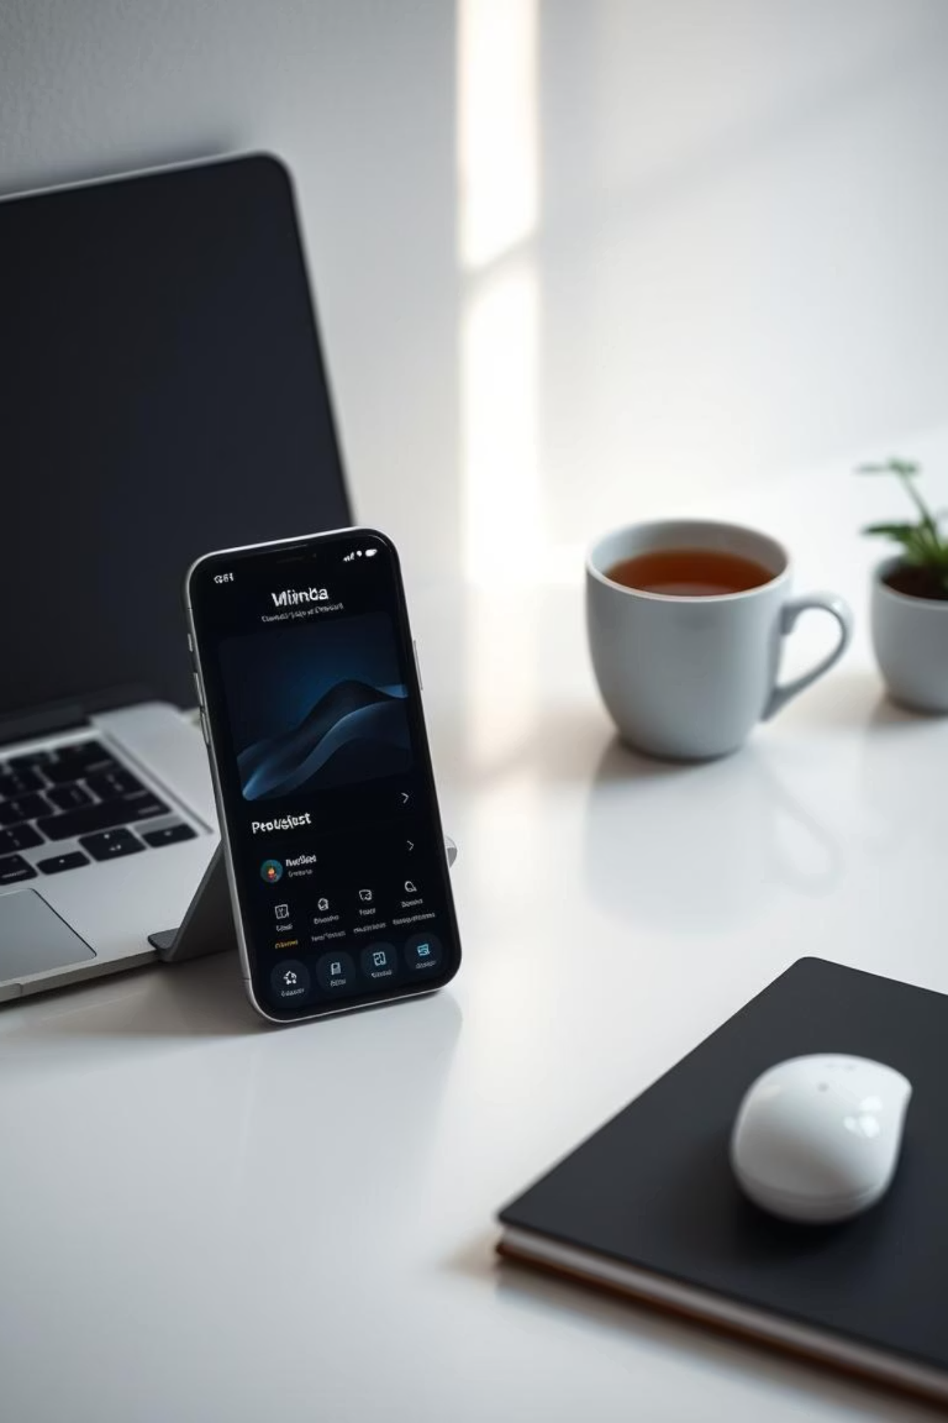
DOZY: Your Minimal Focus & Digital Wellness Companion
Discover DOZY, the beautifully minimal web app designed to help you master your focus, cultivate calm, and take control of your digital well-being.

Slide 2








The Power of Pomodoro
Focused Work Intervals
Short, Rejuvenating Breaks
Utilize the Pomodoro technique for structured 25-minute work sessions, maximizing concentration.
Take 5-minute breaks to recharge, preventing burnout and maintaining mental clarity.
Enhanced Productivity
Longer Reflection Time
Break down large tasks, reduce procrastination, and improve overall time management.
After four Pomodoros, enjoy a longer break (15-30 mins) for deeper rest and reflection.

Slide 3
Core Features for Effortless Productivity
Focus Timer
Toggleable To-Do List
Intuitive countdown for Pomodoro sessions.
Keep tasks in sight without distraction.
Customizable durations to fit your workflow.
Easily add, mark complete, or hide tasks.
Visual progress bar for clear tracking.
Integrates seamlessly with your focus sessions.
Collapsible Notes
Ambient Sound Controls
Jot down ideas or reminders on the fly.
Curated soundscapes for enhanced concentration.
Expand and collapse as needed to maintain focus.
Rain, forest, or gentle white noise options.
Keep all relevant information in one place.
Create your ideal auditory focus environment.

Slide 4
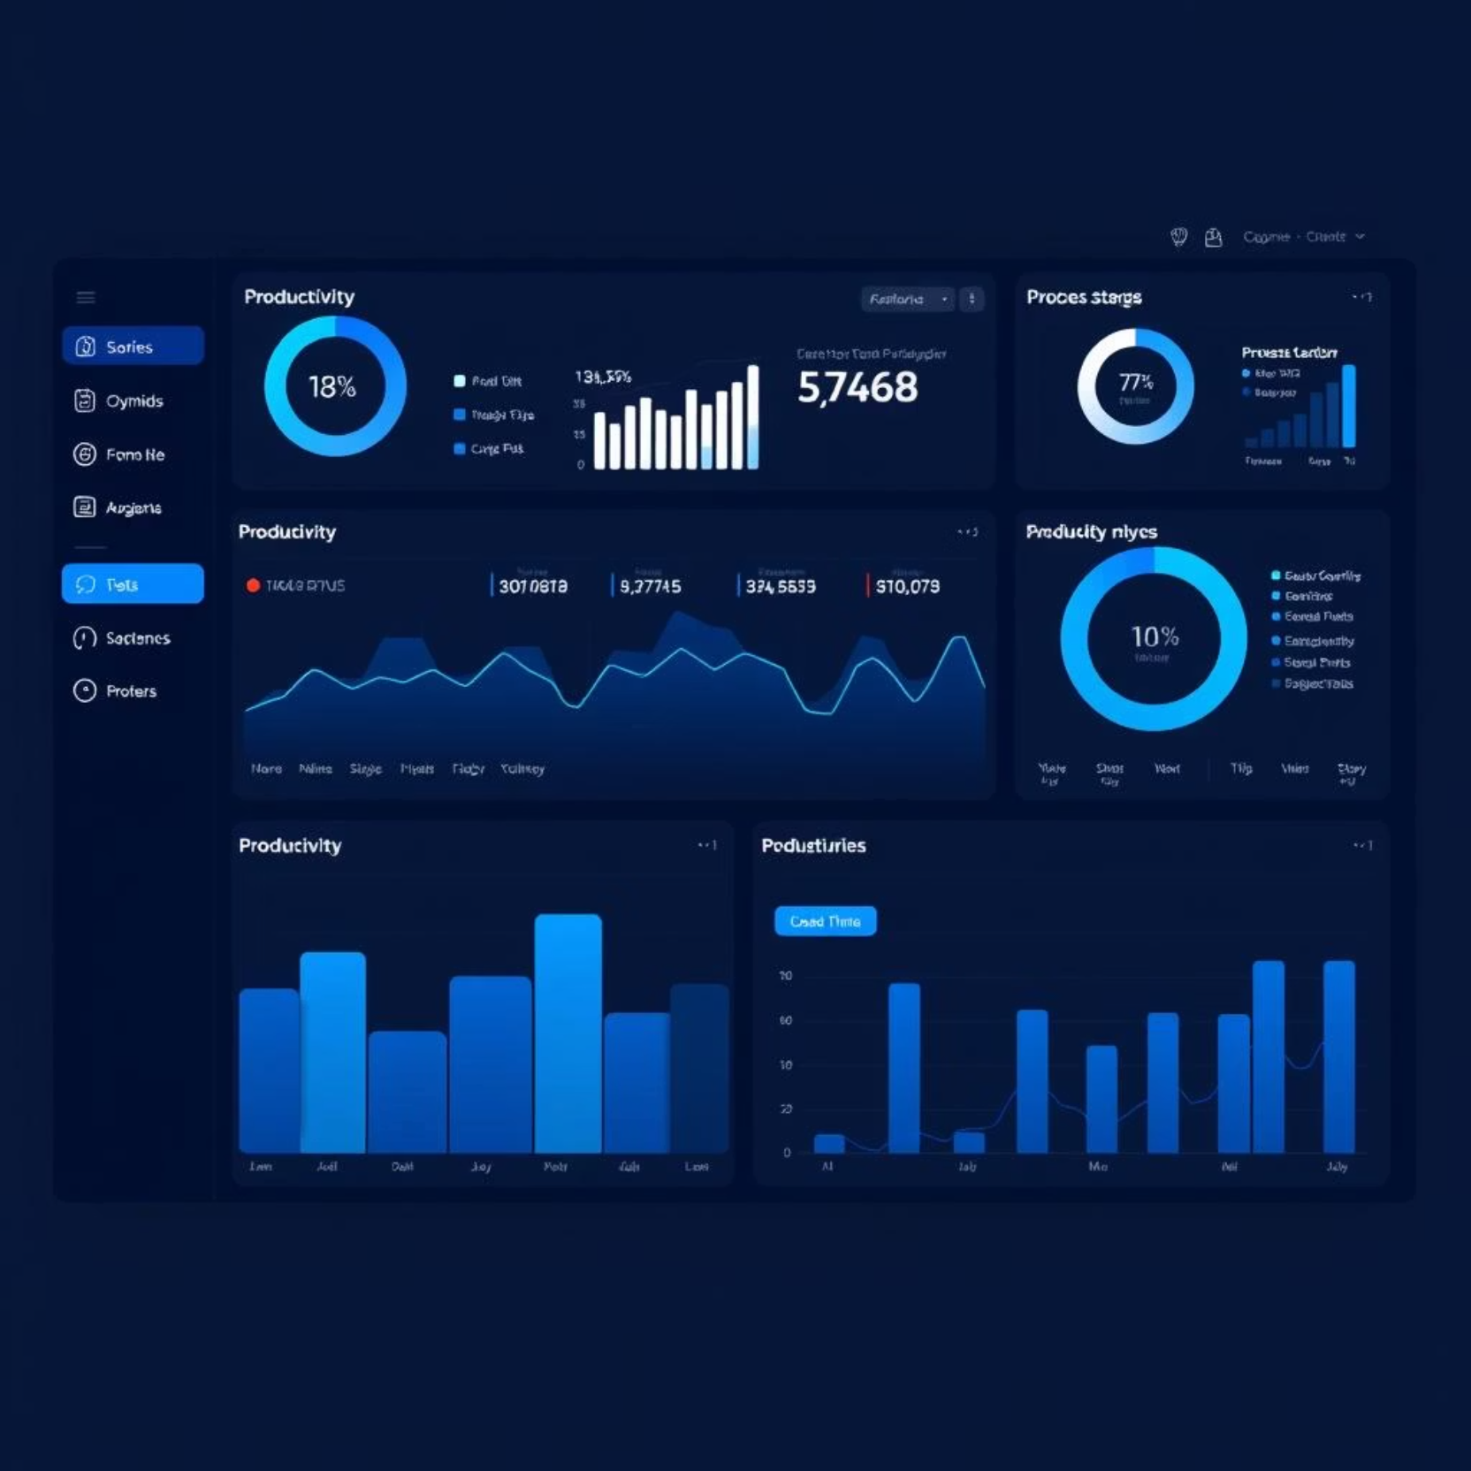
Your Personalized Productivity Hub
DOZY's personalized dashboard offers a clear overview of your focus patterns and achievements. Track your completed Pomodoros, time spent on tasks, and overall productivity trends. This insight empowers you to understand your habits and refine your workflow for optimal performance.

Slide 5





Addiction Remob Mode: Gentle Digital Intervention
Focus Pattern Tracking
DOZY intelligently monitors your digital habits, identifying potential distractions and periods of lost focus.
Smart Nudges
Receive subtle, encouraging nudges that guide you back to your tasks without being intrusive or disruptive.
Progress Tracking
Visualize your journey towards healthier digital habits with clear, digestible progress reports.
Subtle Gamification
Engage with gentle gamified elements that reward consistent focus and positive digital choices.

Slide 6
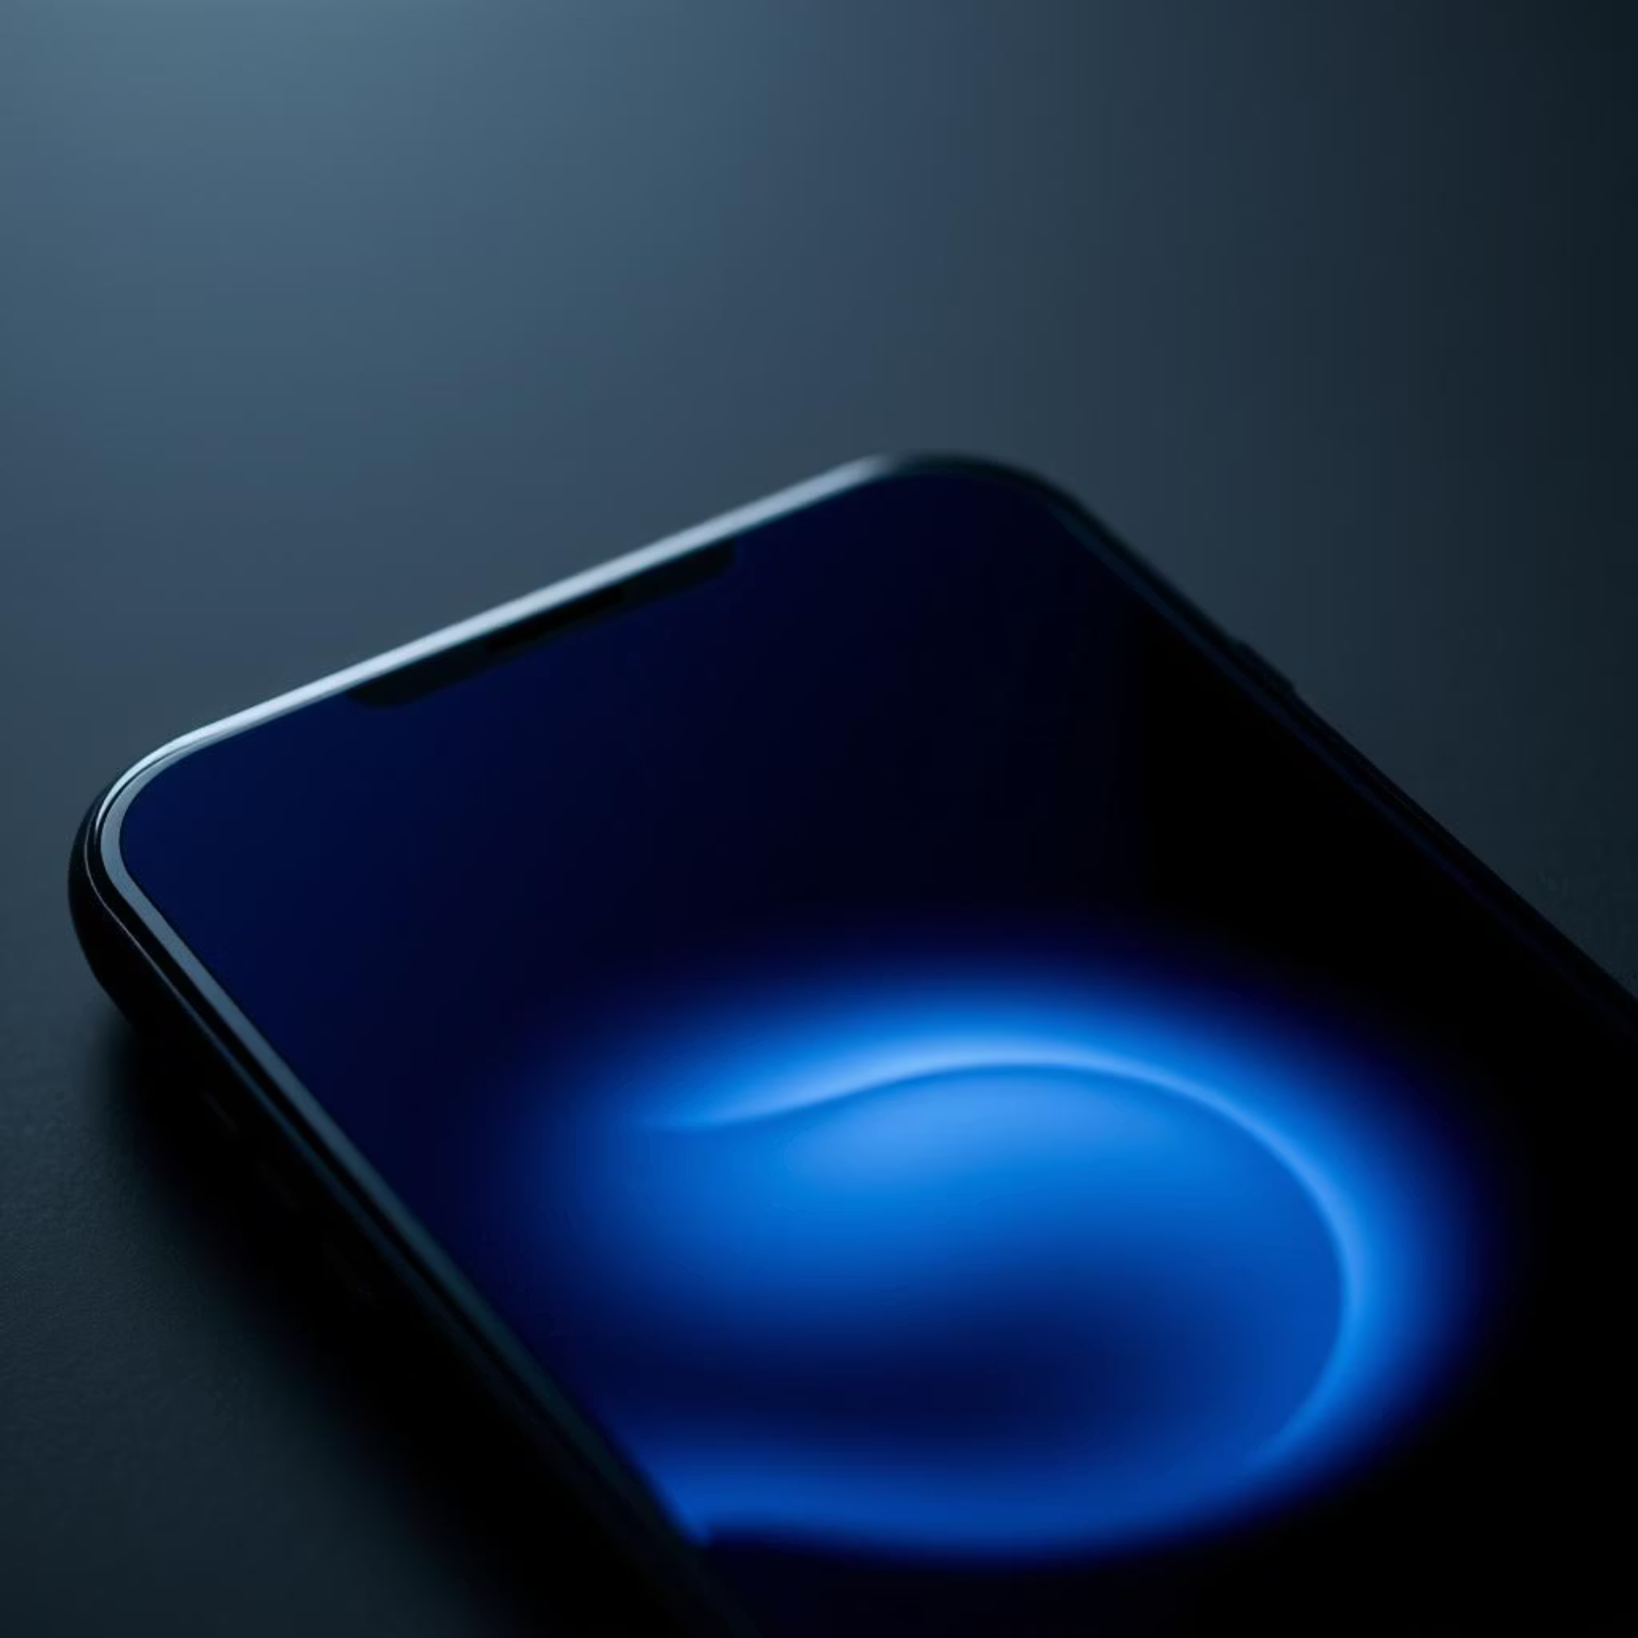
Zen Aesthetic & Seamless Integration
Experience a distraction-free environment with DOZY's dark, zen-inspired aesthetic and smooth, rounded UI. Every element is designed to promote calm and focus, making productivity feel natural and effortless.
Enhance your focus with seamless Spotify integration, allowing you to control your favorite focus music directly within the app.

Slide 7

Why Choose DOZY?
Minimalist Design
Clean, uncluttered interface that minimizes visual noise.
Mobile-First
Optimized for on-the-go productivity and digital well-being.
Holistic Well-being
Beyond productivity, it fosters healthier digital habits.
Continuous Improvement
Dedicated to evolving with user needs for sustained focus.

Slide 8
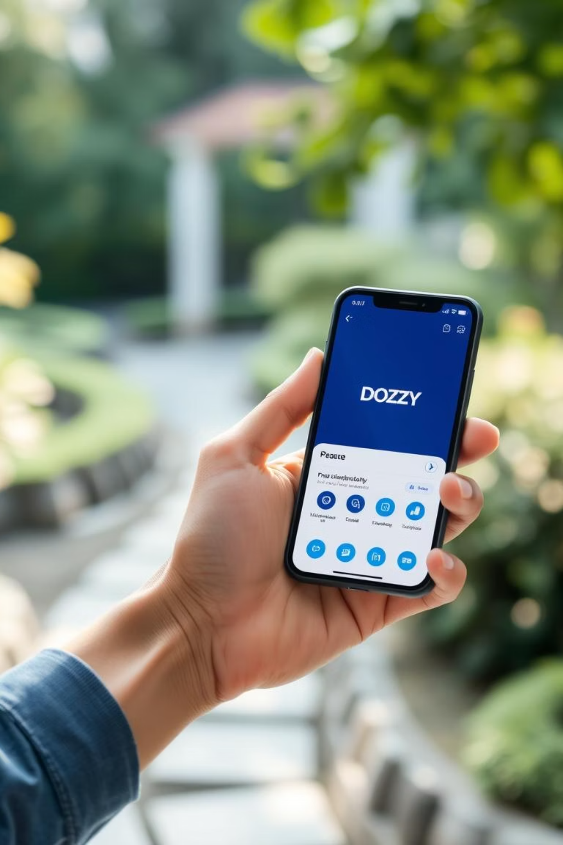
Start Your Journey to Enhanced Focus
DOZY is more than just a productivity tool; it's a companion for a calmer, more focused, and digitally balanced life. Take the first step towards transforming your digital habits and unlocking your full potential.

